Slide 1

Get Help App
Project Plan
& Risk Management Strategy
By Team Starneo

Slide 2




Introduction
Proposed Approach
Deliverable & Technical Requirements
Related Documents & Project Plans
Conclusion

Slide 3
Proposed Approach
0- Overall Approach
1- Requirement phase
2- Design phase

Slide 4
Proposed Approach
3- Implementation phase
4- Testing phase
5- Debugging phase

Slide 5
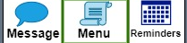
Deliverables - Base
Base:
Prototype
Registration System
Help/Expert List
Reminder List
Message Board

Slide 6
Deliverables - Stretch & Next Version
Next Version:
Building The App
Stretch:
Scrolling Buttons
General Setting
Theme Setting
Alarm Setting

Slide 7
Technical Requirements - For Team Member
Sharing Information:
Github
Google Drive
Trello
Communicate:
Microsoft Teams

Slide 8
Technical Requirements - For Design
Design:
IBM(Diagrams)
Database Modeling(Entity Relationship Diagrams )
Draw.io(Prototype)
Agile(Develop)
Java Programming Language (Programming)

Slide 9
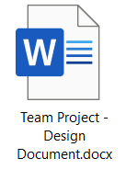
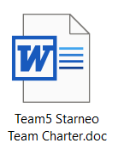
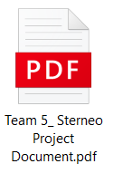
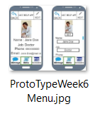
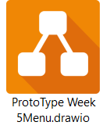
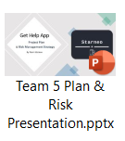
Related Documents

Slide 10
Project Plans
The work to be done
Tasks priority order:
Low
Medium
High
12 weeks to be filled out.

Slide 11
Project Plans
Tasks title / name.
Tasks Summary.
Phase/Task Leadership.

Slide 12
Risk Register - Medium
Meeting the user wants.
Team Management.
Time Management.

Slide 13
Risk Register - High
Documentation Process.
Testing and Debugging.
Presenting.

Slide 14


Slide 15

Q & A

Slide 16

Thank You! That’s All Folks!

